Slide 1
雲端數據運算與分析
張家瑋 博士
助理教授
國立臺中科技大學資訊工程系

Slide 2

Javascript & Ajax Programming
AJAX
Javascript

Slide 3
Javascript introduction
<script> … </script> 擺在 <head> … </head> ，會優先載入 Javascript
<script> … </script> 擺在 <body> … </body> ，會優先載入 html
外部引入 js 檔案於 <head> 或 <body>，可使用 <script src="js/main.js"></script>
請注意：引入外部 js 檔案時，不可在中間寫 js code！

Slide 4
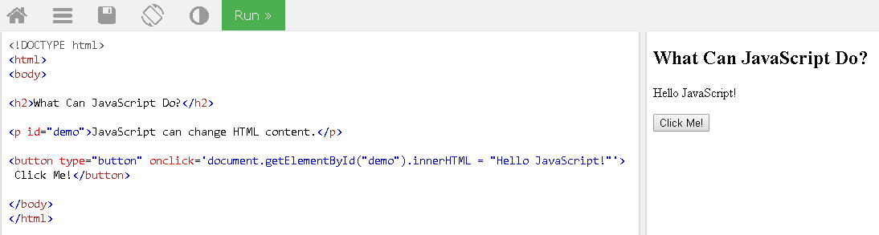
Javascript introduction

Slide 5
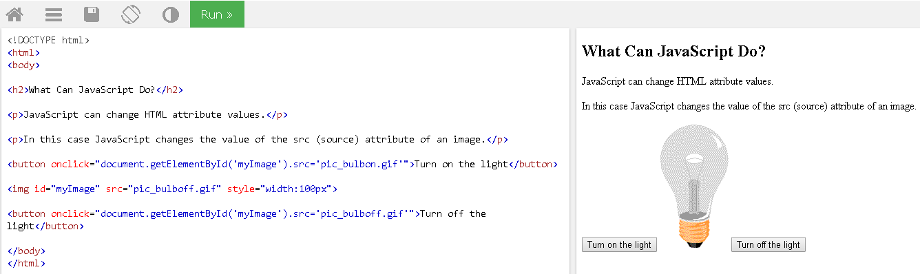
Javascript introduction

Slide 6
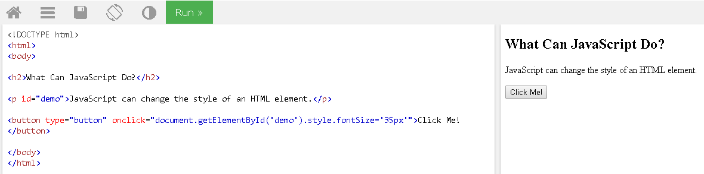
Javascript introduction

Slide 7
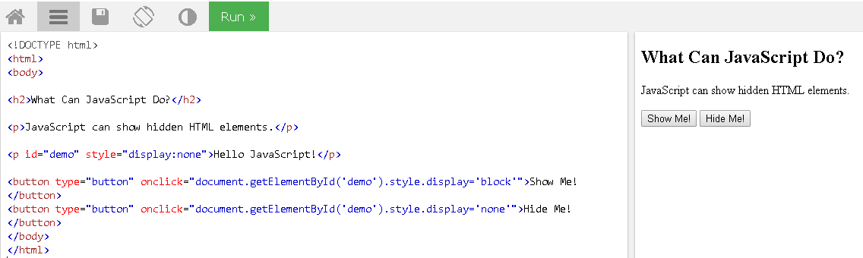
Javascript introduction

Slide 8
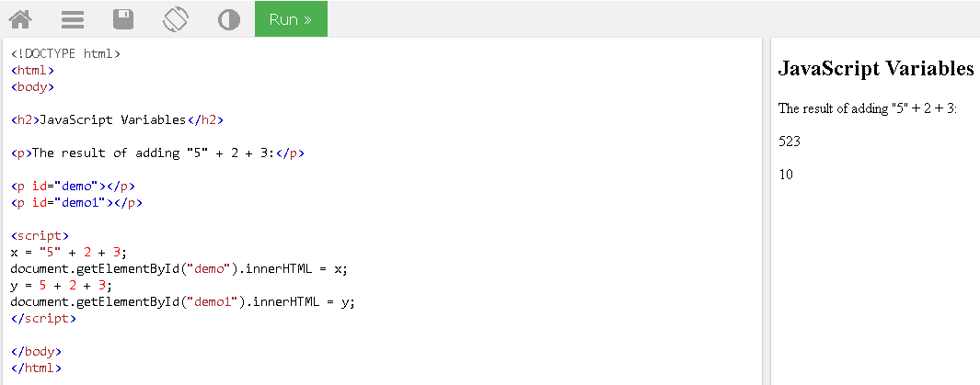
Javascript Variables

Slide 9
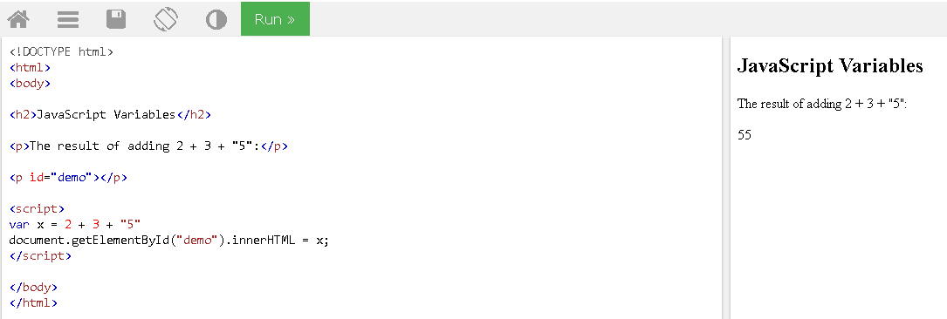
Javascript Variables

Slide 10
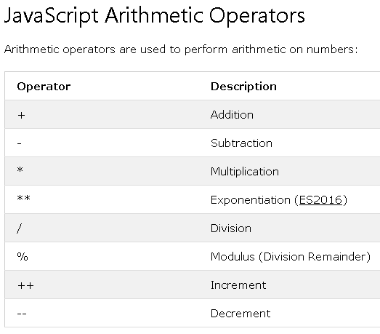
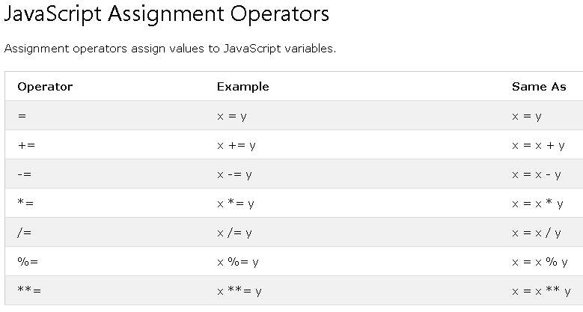
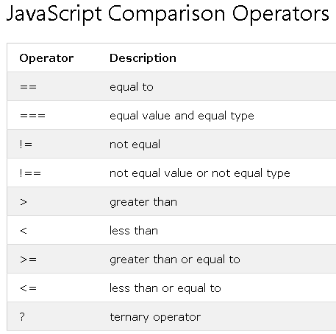
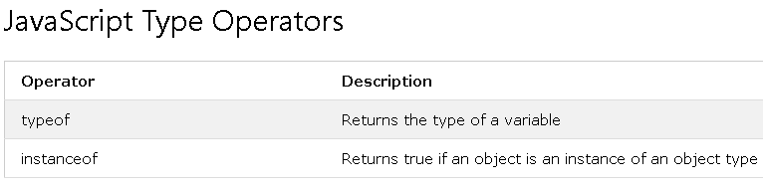
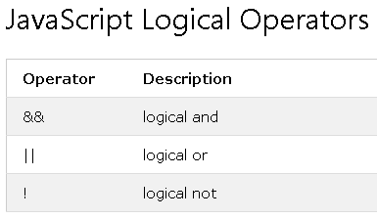
Javascript operators

Slide 11
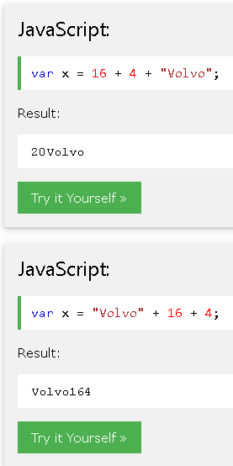
Javascript Data types

Slide 12
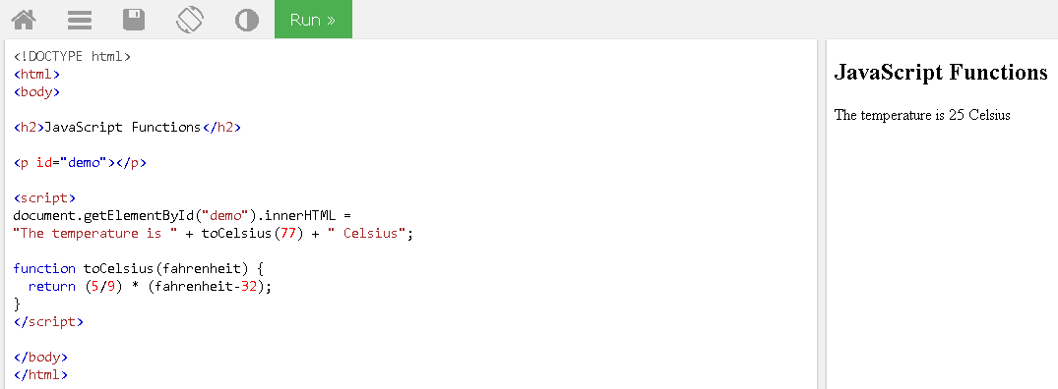
Javascript Functions

Slide 13
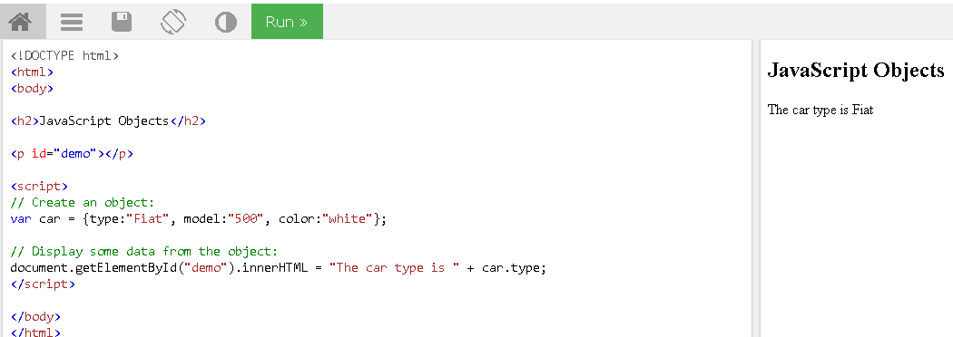
Javascript objects

Slide 14
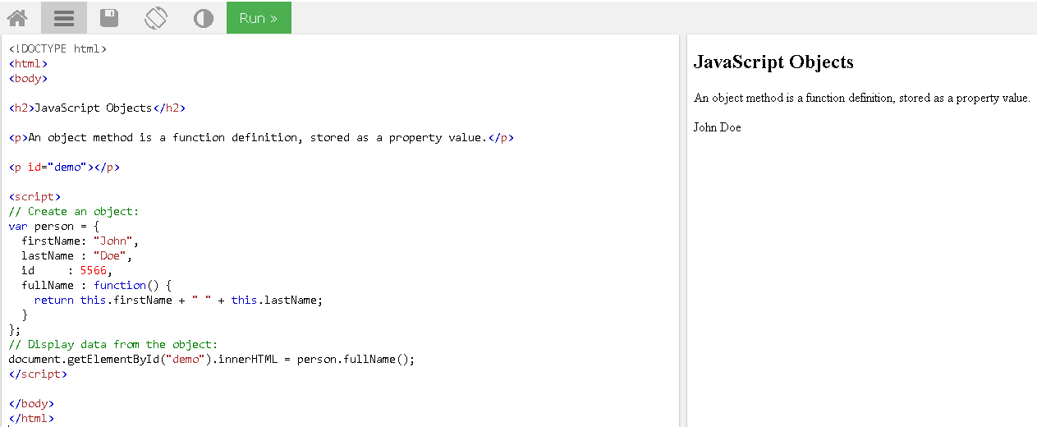
Javascript objects

Slide 15
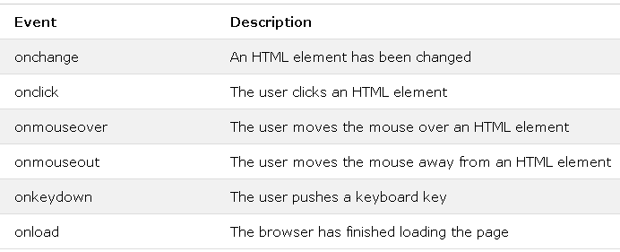
Javascript EVENTS

Slide 16
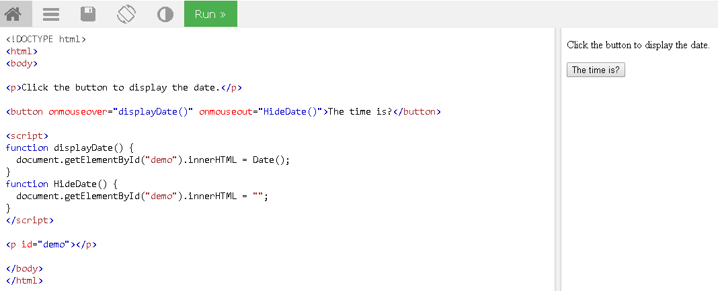
Javascript EVENTS

Slide 17
Javascript ARRAYS
var cars = [ "Saab", "Volvo", "BMW" ];
var cars = new Array("Saab", "Volvo", "BMW");

Slide 18
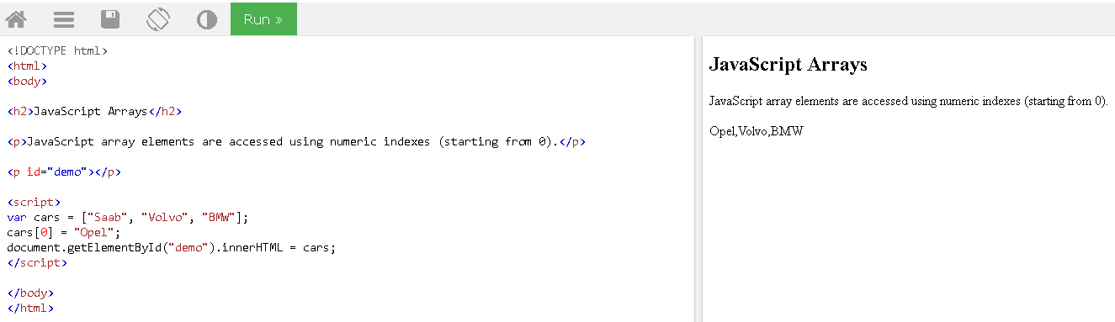
Javascript ARRAYS

Slide 19
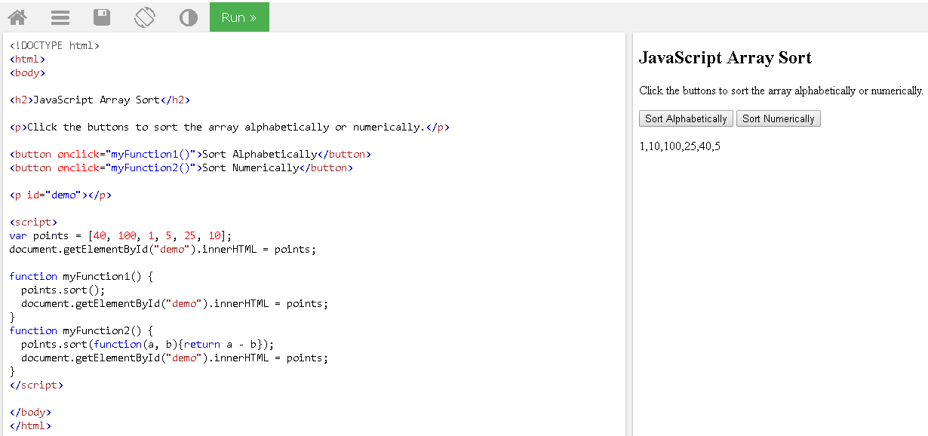
Javascript ARRAY SORT

Slide 20
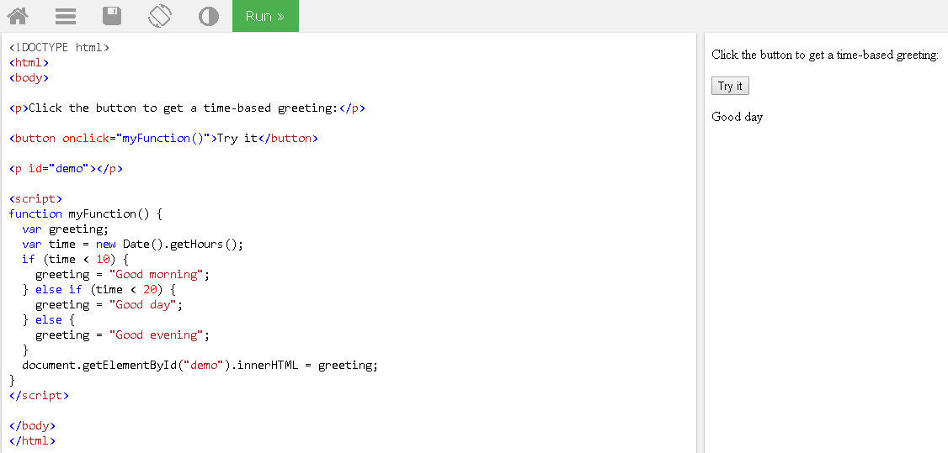
Javascript IF…ELSE…

Slide 21
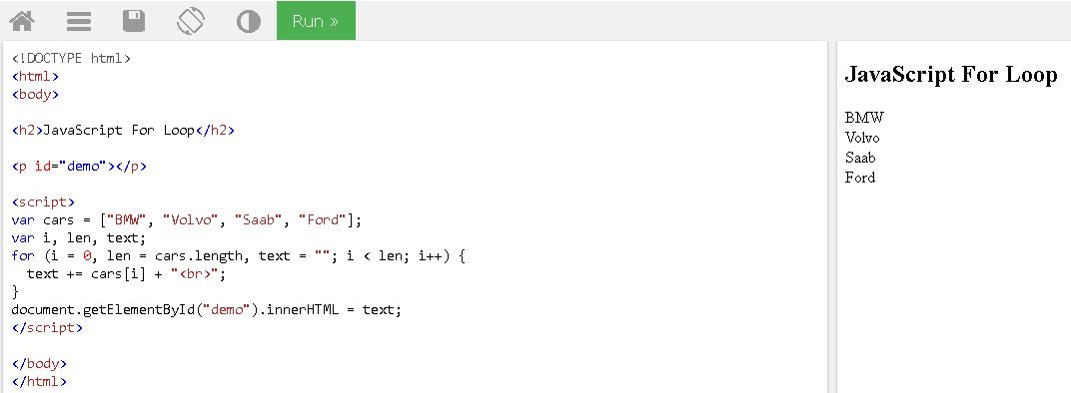
Javascript FOR LOOP

Slide 22
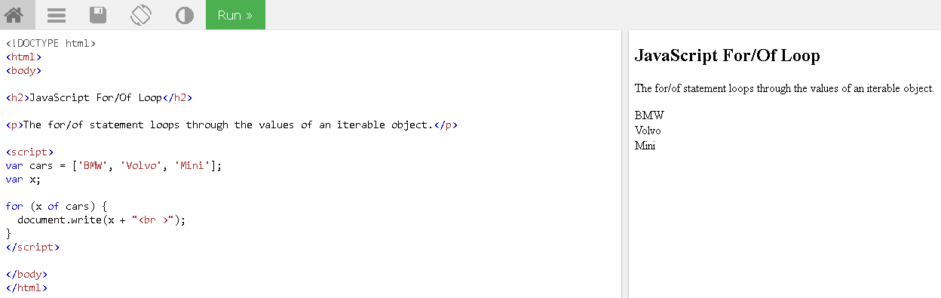
Javascript FOR LOOP

Slide 23
What is AJAX?
Asynchronous JavaScript And XML (AJAX)
A browser built-in XMLHttpRequest object (to request data from a web server)
JavaScript and HTML DOM (to display or use the data)
AJAX allows web pages to be updated asynchronously by exchanging data with a web server behind the scenes. This means that it is possible to update parts of a web page, without reloading the whole page.

Slide 24
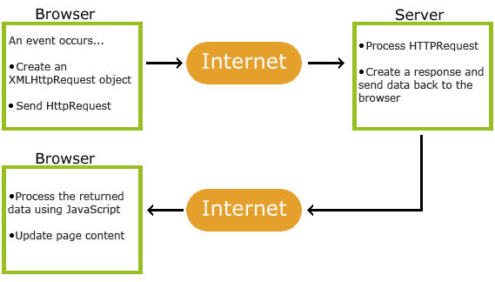
How AJAX Works
An event occurs in a web page (the page is loaded, a button is clicked)
An XMLHttpRequest object is created by JavaScript
The XMLHttpRequest object sends a request to a web server
The server processes the request
The server sends a response back to the web page
The response is read by JavaScript
Proper action (like page update) is performed by JavaScript

Slide 25
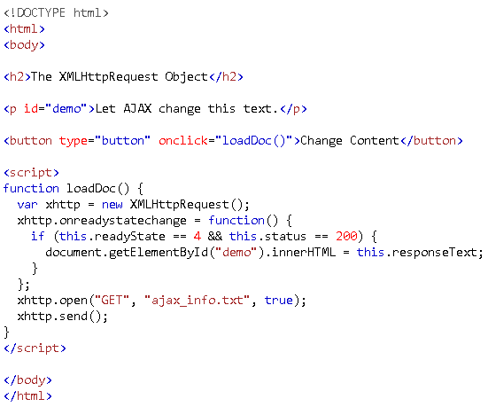
BASIC EXAMPLE Load data from local site
var xhttp = new XMLHttpRequest ();
xhttp.onreadystatechange
this.readyState == 4
this.status == 200
xhttp.open(method, url, async )
xhttp.send(string )

Slide 26
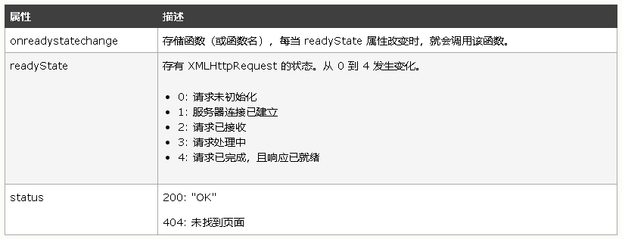
Onreadystatechange 的三個重要屬性

Slide 27
GET or POST
與POST相比，GET更簡單也更快，並且在大部分情況下都能用。
然而，在以下情況中，請使用POST請求：
無法使用緩存文件（更新服務器上的文件或數據庫）
向服務器發送大量數據（POST沒有數據量限制）
發送包含未知字符的用戶輸入時，POST比GET更穩定也更可靠

Slide 28
異步與同步
Async 是接收到需求，不用一直等到需求完成再執行其他需求。
Async 與 Sync 的差別在於：發送需求的人是否需要等到需求完成才可以執行其他事情。

Slide 29
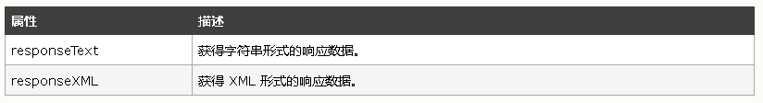
服務器響應
document.getElementById("demo").innerHTML = this.responseText;

Slide 30
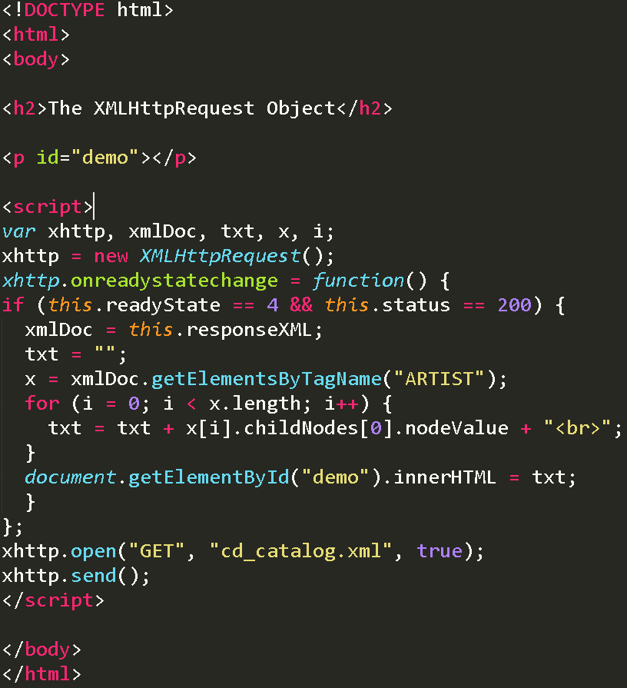
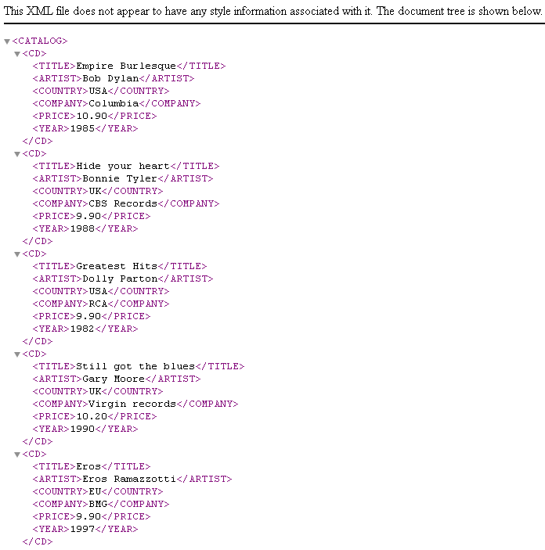
服務器響應 XML
https://www.w3schools.com/js/cd_catalog.xml

Slide 31
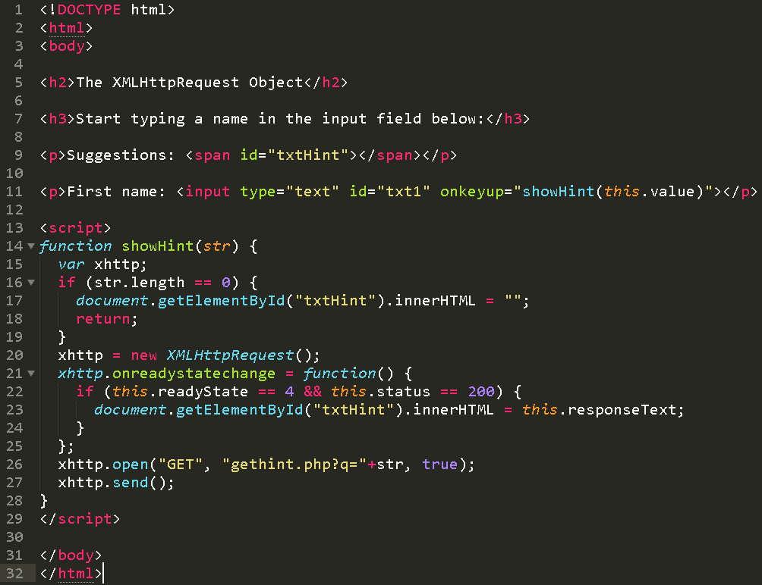
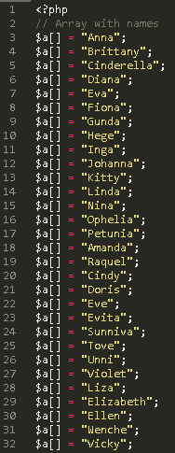
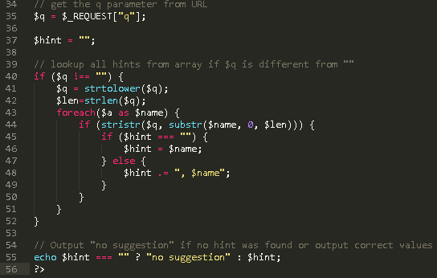
服務器響應 FROM PHP

Slide 32
Thank you
自學資源
W3schools
Codecademy

